Slide 1
Relational Algebra

Slide 2
Relational Algebra
Relational algebra is a procedural query language, which takes instances of relations as input and yields instances of relations as output. It uses operators to perform queries.
An operator can be either unary or binary. They accept relations as their input and yield relations as their output.
Relational algebra is performed recursively on a relation and intermediate results are also considered relations.

Slide 3
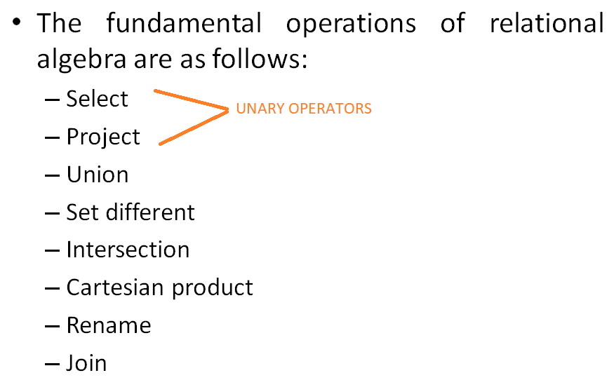
Relational Algebra

Slide 4
Example Instances
R1
S1
S2

Slide 5
Relational Algebra
Select Operation (σ)
It selects tuples that satisfy the given predicate from a relation.
Notation : σ_{p}(r)
Where σ stands for selection predicate and r stands for relation. p is prepositional logic formula which may use connectors like and, or, and not. These terms may use relational operators like =, ≠, ≥, < , >, ≤.

Slide 6
Relational Algebra
Select Operation (σ)
Examples:
σ_{subject = "database"}(Books)
Selects tuples from books where subject is 'database'.

Slide 7
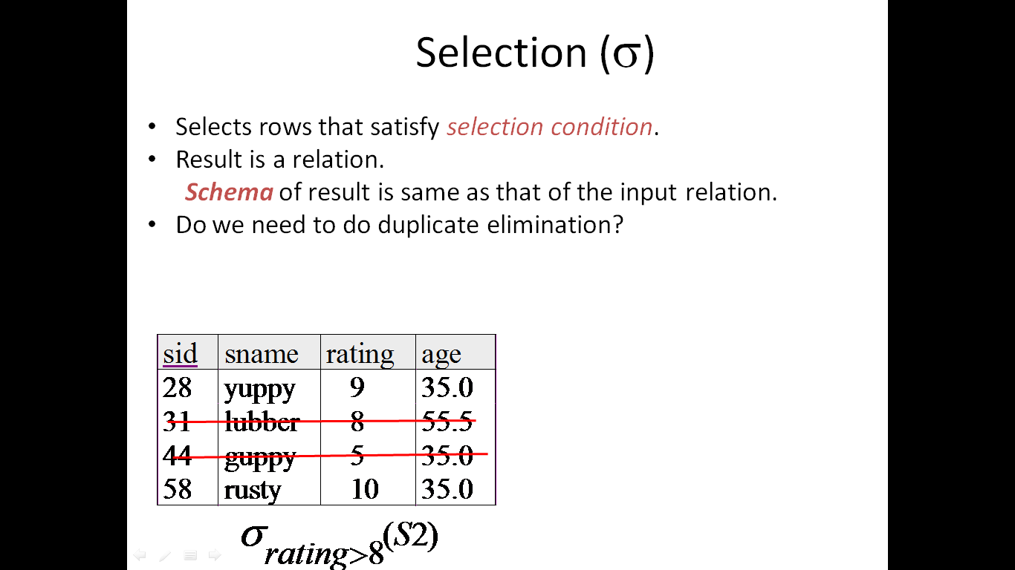

Slide 8
Relational Algebra
Select Operation (σ)
Examples:
σsubject = "database" and price = "450"(Books)
Selects tuples from books where subject is 'database' and 'price' is 450.

Slide 9
Relational Algebra
Select Operation (σ)
Examples:
σsubject = "database" and price = "450" or year > "2010"(Books)
Selects tuples from books where subject is 'database' and 'price' is 450 or those books published after 2010.

Slide 10
Relational Algebra
Project Operation (∏)
It projects column(s) that satisfy a given predicate.
Notation : ∏_{A1, A2, An} (r)
Where A₁, A₂ , A_{n} are attribute names of relation r.
Duplicate rows are automatically eliminated, as relation is a set.

Slide 11
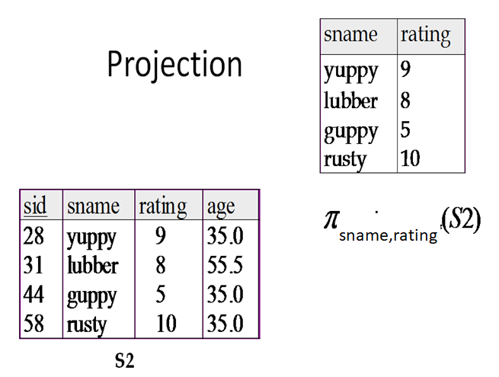

Slide 12
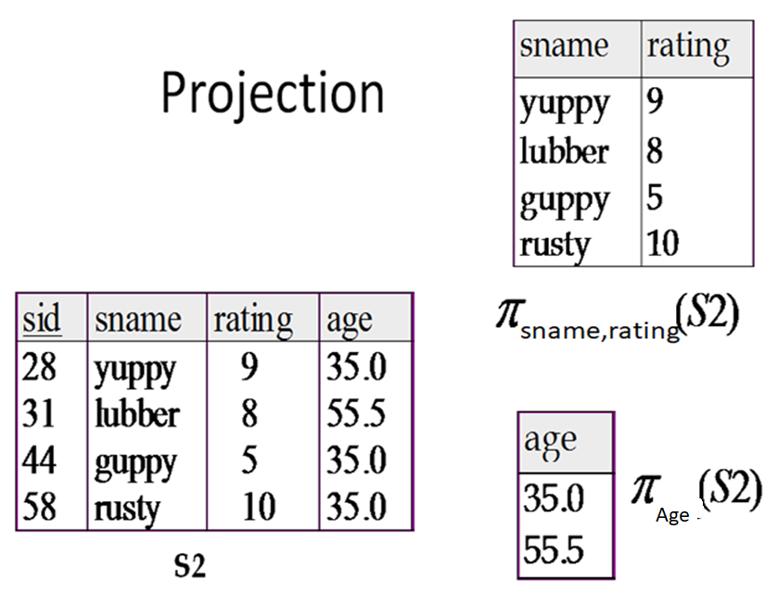

Slide 13
Relational Algebra
Project Operation (∏)
Example
∏_{subject, author} (Books)
Selects and projects columns named as subject and author from the relation Books.

Slide 14
Relational Algebra
Union Operation (∪)
It performs binary union between two given relations and is defined as
r ∪ s = { t | t ∈ r or t ∈ s}
Notation : r U s
Where r and s are either database relations or relation result set (temporary relation).

Slide 15
Relational Algebra
Union Operation (∪)
For a union operation to be valid, the following conditions must hold:
r, and s must have the same number of attributes.
Attribute domains must be compatible.
Duplicate tuples are automatically eliminated.

Slide 16
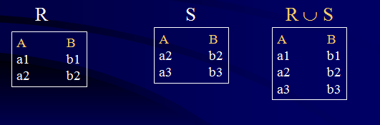
Relational Algebra
Union Operation (∪)
Example

Slide 17
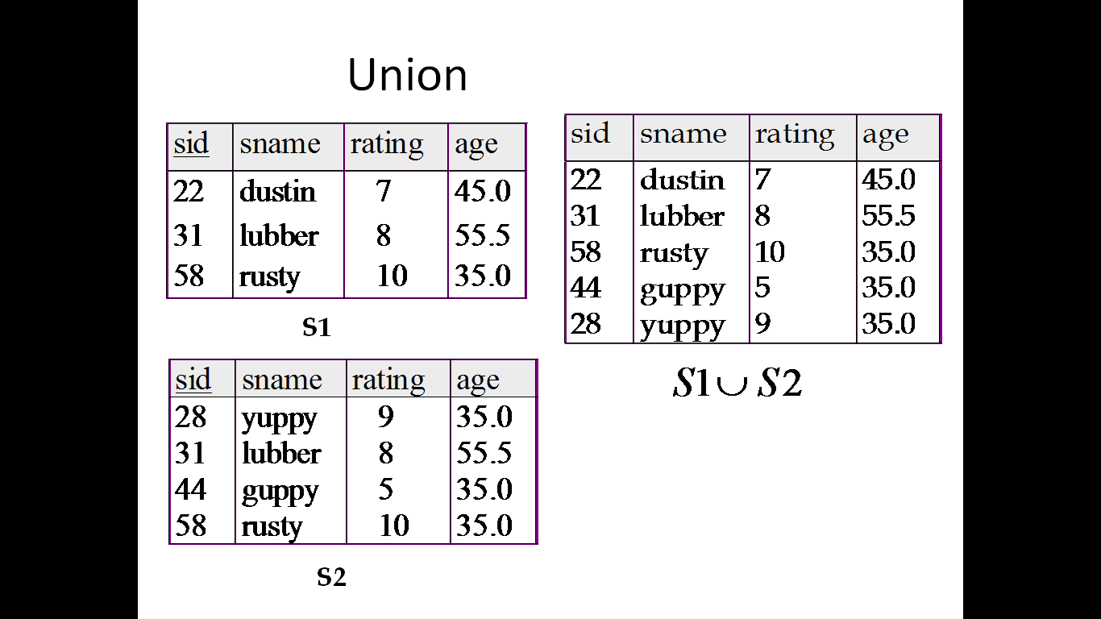

Slide 18
Relational Algebra
Union Operation (∪)
Example
∏ _{author} (Books) ∪ ∏ _{author} (Articles)
Projects the names of the authors who have either written a book or an article or both.

Slide 19
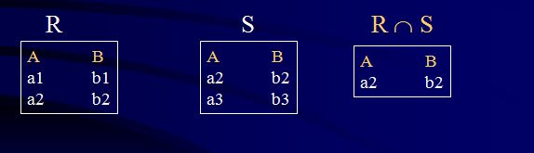
Relational Algebra
Intersection Operation
Takes the set of rows that are common to each relation
Participating relations must be compatible

Slide 20
Intersection
S1
S2

Slide 21
Relational Algebra
Set Difference (−)
The result of set difference operation is tuples, which are present in one relation but are not in the second relation.
Notation : r − s
Finds all the tuples that are present in r but not in s.

Slide 22
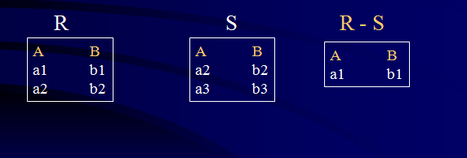
Relational Algebra
Set Difference (−)
Example

Slide 23
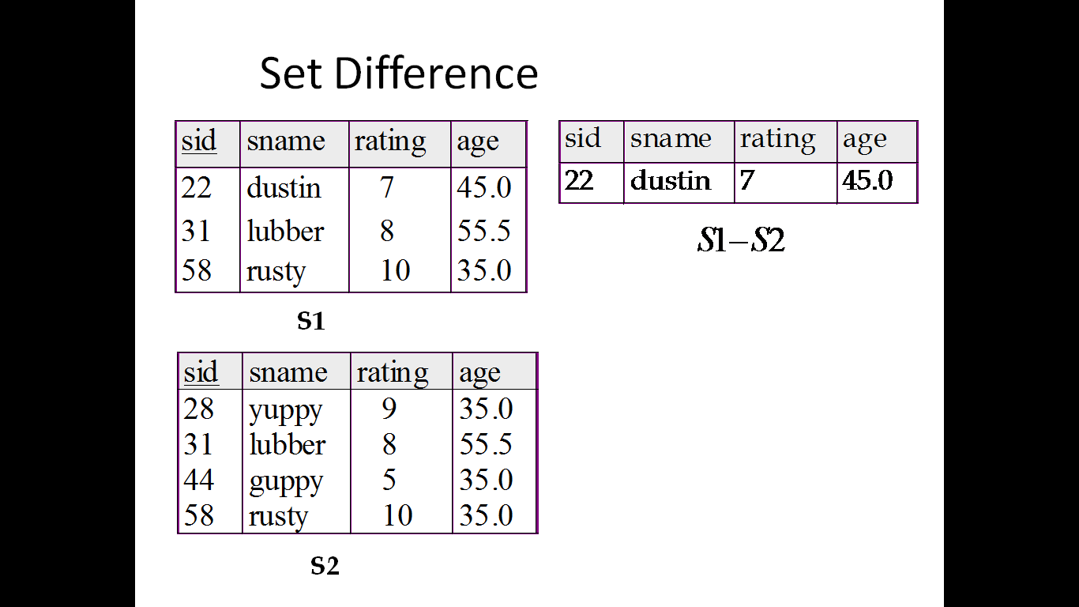

Slide 24
Set Difference
S1
S2 – S1
S2

Slide 25
Relational Algebra
Set Difference (−)
Example
∏ _{author} (Books) − ∏ _{author} (Articles)
Provides the name of authors who have written books but not articles.

Slide 26
Relational Algebra
Cartesian Product (Χ)
Combines information of two different relations into one.
Notation : r Χ s
Where r and s are relations and their output will be defined as :
r Χ s = { q t | q ∈ r and t ∈ s}

Slide 27
Cross-Product
S1 × R1: Each row of S1 paired with each row of R1.
Q: How many rows in the result?
Result schema has one field per field of S1 and R1, with field names `inherited’ if possible.
May have a naming conflict: Both S1 and R1 have a field with the same name.

Slide 28
Cross Product Example
R1
S1
S1 X R1 =

Slide 29
JOIN
SQL Join is used to fetch data from two or more tables, which is joined to appear as single set of data. It is used for combining column from two or more tables by using values common to both tables.

Slide 30
Example: Joining Two Tables
Enrolled
Students
Relational Algebra

Slide 31
Types of JOIN
Inner or Equi Join
Outer
Left
Right

Slide 32
Cross JOIN or Cartesian Product
This type of JOIN returns the cartesian product of rows from the tables in Join. It will return a table which consists of records which combines each row from the first table with each row of the second table.

Slide 33
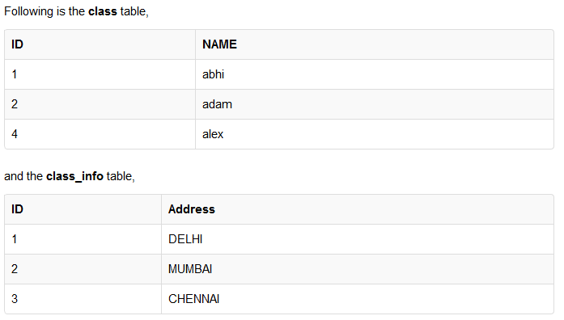
Example of Cross JOIN

Slide 34
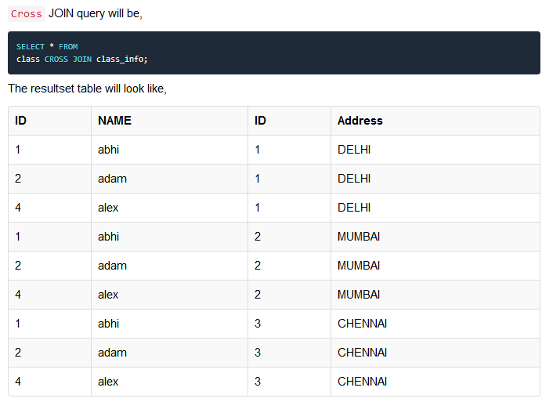

Slide 35
INNER Join or EQUI Join
This is a simple JOIN in which the result is based on matched data as per the equality condition specified in the SQL query.
Inner Join Syntax is,
SELECT column-name-list FROM table-name1 INNER JOIN table-name2 WHERE table-name1.column-name = table-name2.column-name;

Slide 36
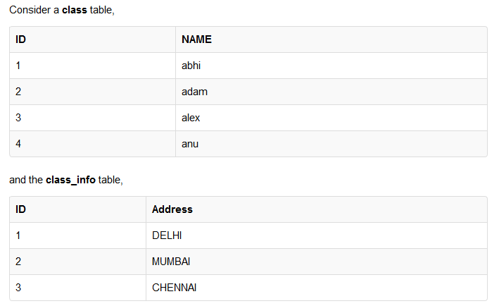
Example of INNER JOIN

Slide 37
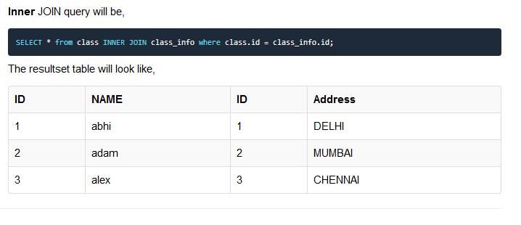
Example of INNER JOIN
Class _{class.id=class_info.id} Class_info
ρ_{cl}(Class) _{cl.id=cli.id} ρ_{cli}(Class_info)

Slide 38
Natural JOIN
Natural Join is a type of Inner join which is based on column having same name and same data type present in both the tables to be joined.
The syntax for Natural Join is,
SELECT * FROM table-name1 NATURAL JOIN table-name2;

Slide 39
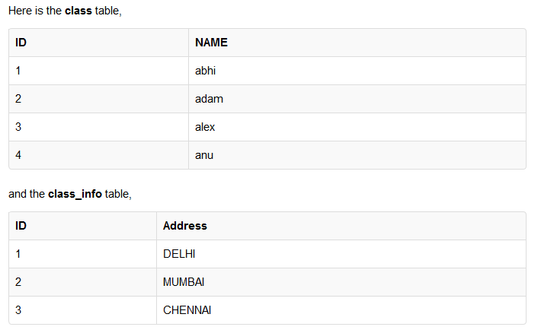
Example of Natural JOIN

Slide 40
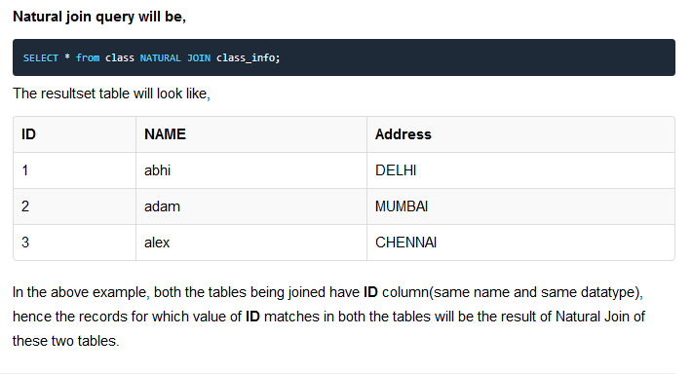
Example of Natural JOIN
Class ⋈ Class_info

Slide 41
OUTER JOIN
Outer Join is based on both matched and unmatched data. Outer Joins subdivide further into,
Left Outer Join
Right Outer Join
Full Outer Join

Slide 42
LEFT Outer Join
The left outer join returns a result set table with the matched data from the two tables and then the remaining rows of the left table and null from the right table's columns.
Syntax for Left Outer Join is,
SELECT column-name-list FROM table-name1 LEFT OUTER JOIN table-name2 ON table-name1.column-name = table-name2.column-name;

Slide 43
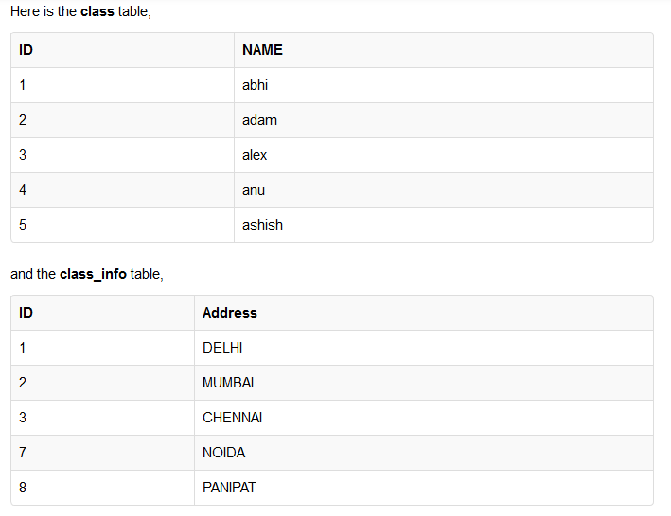
Example of Left Outer Join

Slide 44
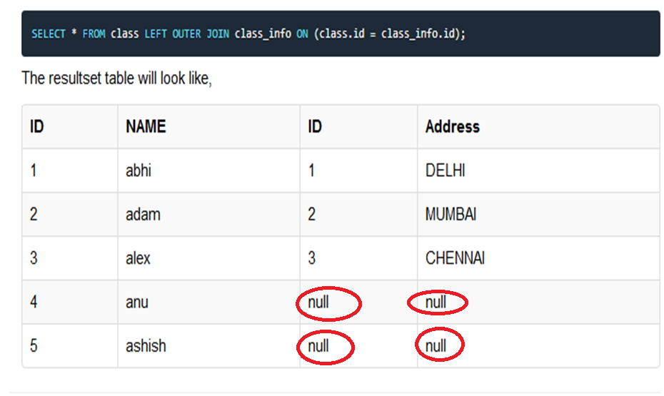
Class _{Class.id = class_info.id} Class_info

Slide 45
RIGHT Outer Join
The right outer join returns a result set table with the matched data from the two tables being joined, then the remaining rows of the right table and null for the remaining left table's columns.
Syntax for Right Outer Join is,
SELECT column-name-list FROM table-name1 RIGHT OUTER JOIN table-name2 ON table-name1.column-name = table-name2.column-name;

Slide 46
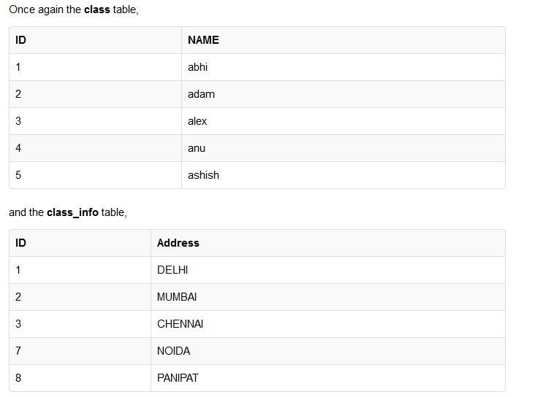

Slide 47
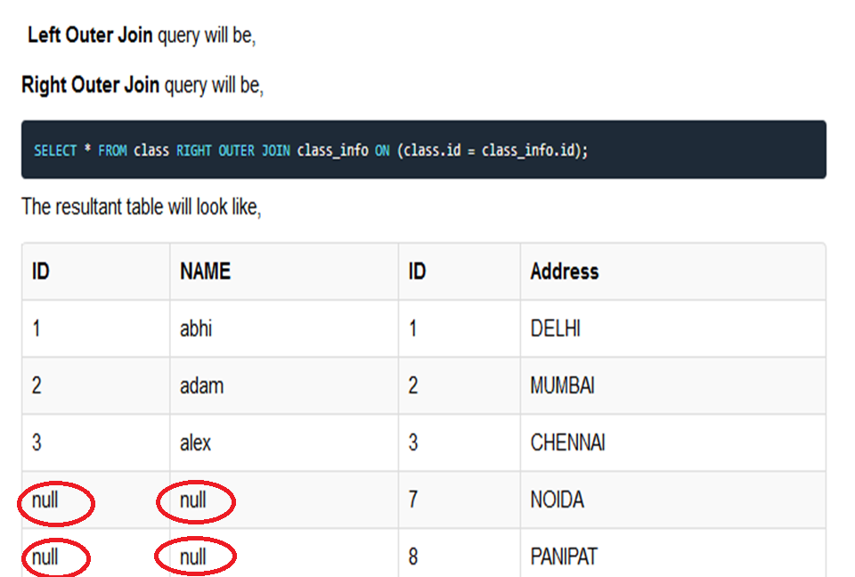
Class _{Class.id = class_info.id} Class_info

Slide 48
Full Outer Join
The full outer join returns a resultset table with the matched data of two table then remaining rows of both left table and then the right table.
Syntax of Full Outer Join is,
` SELECT column-name-list FROM table-name1 FULL OUTER JOIN table-name2 ON table-name1.column-name = table-name2.column-name;

Slide 49
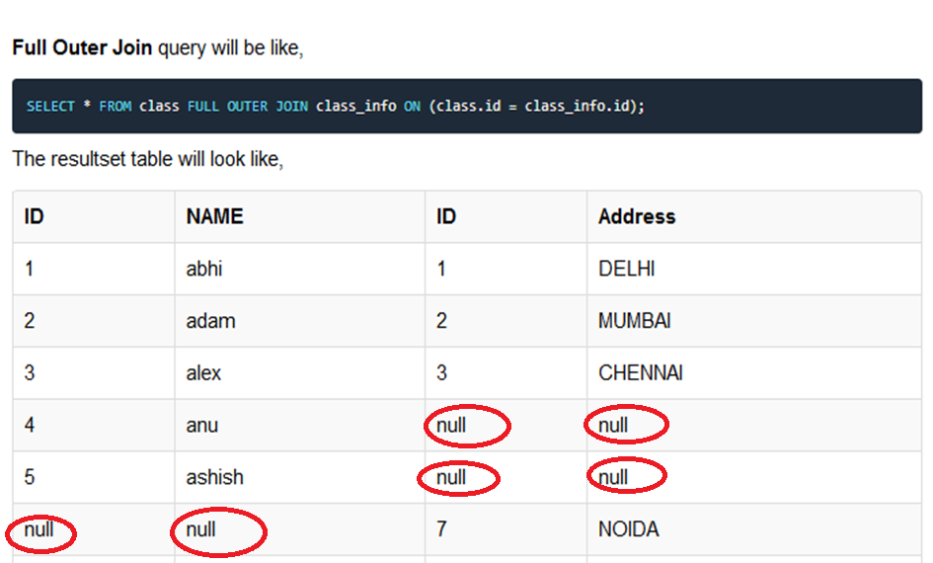
Class _{Class.id = class_info.id} Class_info

Slide 50
Select(σ) | The SELECT operation is used for selecting a subset of the tuples according to a given selection condition
Projection(π) | The projection eliminates all attributes of the input relation but those mentioned in the projection list.
Union Operation(∪) | UNION is symbolized by symbol. It includes all tuples that are in tables A or in B.
Set Difference(-) | - Symbol denotes it. The result of A - B, is a relation which includes all tuples that are in A but not in B.
Intersection(∩) | Intersection defines a relation consisting of a set of all tuple that are in both A and B.
Cartesian Product(X) | Cartesian operation is helpful to merge columns from two relations.
Inner Join | Inner join, includes only those tuples that satisfy the matching criteria.

Slide 51
Theta Join(θ) | The general case of JOIN operation is called a Theta join. It is denoted by symbol θ.
EQUI Join | When a theta join uses only equivalence condition, it becomes a equi join.
Natural Join(⋈) | Natural join can only be performed if there is a common attribute (column) between the relations.
Outer Join | In an outer join, along with tuples that satisfy the matching criteria.
Left Outer Join | In the left outer join, operation allows keeping all tuple in the left relation.
Right Outer join | In the right outer join, operation allows keeping all tuple in the right relation.
Full Outer Join | In a full outer join, all tuples from both relations are included in the result irrespective of the matching condition.

